Slide 1

LikeMinded
Personality-Based Matching Platform
By: Bader Merheb & Charbel Youssef

Slide 2

Overview
01
03
What is LikeMinded and
Why was it built?
Architecture & Technology Stack
02
04
Quick Demo
Challenges

Slide 3


1.a
What is LikeMinded?
Personality-Based dating platform
No swiping
Guaranteed matching
AI driven platform
Powered by a matching algorithm

Slide 4

1.b
01
What is LikeMinded?
Why was it built?
Personality over appearance
Lack of depth and long-term potential in current apps
Easier way start to conversations

Slide 5


Some problems that can be solved with LikeMinded
01
Poor compatibility between matched users
02
High drop-off after initial matches
03
Low conversion of matches into meaningful relationships

Slide 6
02
Quick Demo

Slide 7

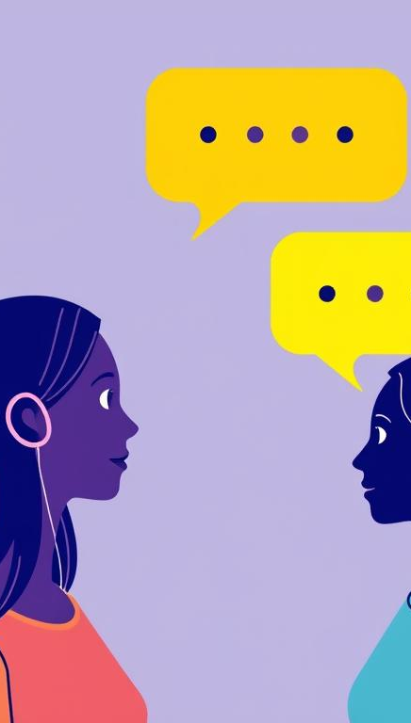




03
Architecture & Technology Stack
01
02
03
Frontend
Backend
Main functionalities
React.js & Tailwind
FastAPI & Supabase (MySQL)
. Chatbot
. Matching Algorithm
. Conversations

Slide 8


Challenges
Designing an accurate matching algorithm without overcomplicating it
Balancing AI guidance with natural, human conversations
Avoiding generic or repetitive chatbot responses
The AI is designed to understand how people communicate and to adjust its tone accordingly, so it feels supportive rather than intrusive or intimidating. The goal was for the AI to guide conversations in a calm, reassuring way, helping users express themselves without making the interaction feel artificial or overwhelming.
We wanted the logic to reflect real compatibility, but at the same time remain explainable, scalable, and efficient. Over-engineering the algorithm could reduce transparency and slow the system, so we focused on a balanced approach that captures personality alignment and preferences while keeping the model understandable and scalable.
Repetition quickly breaks trust and engagement. To address this, we focused on maintaining conversational context and adapting responses based on the user’s behavior and previous interactions, ensuring that conversations feel dynamic, relevant, and personalized over time.

Slide 9
Thank you！

